Slide 1
Chương 1
Giới thiệu
ĐHBK Tp HCM - Khoa Đ-ĐT
BMĐT
Môn học: Xử lý tín hiệu số với FPGA
GVPT: Nguyễn Lý Thiên Trường
Email: truongnguyen@hcmut.edu.vn
203-B3

Slide 2
HDL
Cơ bản về Verilog
Mô tả mạch tổ hợp
Mô tả mạch tuần tự
Mảng và bộ nhớ
Mô tả máy trạng thái

Slide 3
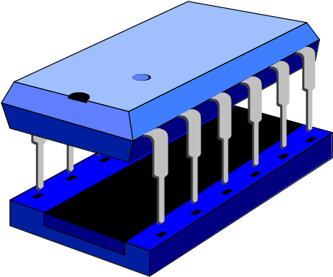
Verilog HDL Basics
Thanasis Oikonomou
Computer Science Dpt.
University of Crete, Greece
e-mail: poisson@csd.uch.gr

Slide 4
What is Verilog
Hardware Description Language (HDL)
Developed in 1984
Standard: IEEE 1364, Dec 1995

Slide 5
Application Areas of Verilog
System Specification
Suitable for all levels
Behavioral level
Not suitable
HW/SW
Partition
Hardware
Specification
Softwre
Specification
ASIC
FPGA
Boards
&
Systems
Software
PLD
Std Parts

Slide 6

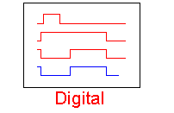
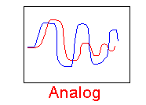
Basic Limitation of Verilog
Description of digital systems only

Slide 7
User Identifiers
Formed from {[A-Z], [a-z], [0-9], _, $}, but ..
.. can’t begin with $ or [0-9]
  myidentifier 
  m_y_identifier 
  3my_identifier 
  $my_identifier 
  _myidentifier$ 
Case sensitivity
  myid ≠ Myid

Slide 8
Comments
// The rest of the line is a comment

Slide 9
Comments
// The rest of the line is a comment
/* Multiple line comment
or block comment */

Slide 10
Comments
// The rest of the line is a comment
/* Multiple line comment
or block comment */
/* Nesting /* comments */ do NOT work */

Slide 11
Verilog Value Set
0 represents low logic level or false condition
1 represents high logic level or true condition
x represents unknown logic level (don’t care)
z represents high impedance logic level (Hi-Z)

Slide 12
Numbers in Verilog (i)
<size>’<radix> <value>
No. of
bits
Binary → b or B
Octal → o or O
Decimal → d or D
Hexadecimal → h or H
Consecutive chars
0-f, x, z
  8’h ax = 1010xxxx
  12’o 3zx7 = 011zzzxxx111

Slide 13
Numbers in Verilog (ii)
You can insert “_” for readability
  12’b 000111010100
  12’b 0001_1101_0100
  12’h 1d4
  12’b 000_111_010_100
  12’o 07_24
Represent the same number
Bit extension
  MSB = 0, x or z ⇒ extend this
    4’b x1 = 4’b xx_x1
    4’b z1 = 4’b zz_z1
    4’b 01 = 4’b 00_01

Slide 14
Numbers in Verilog (ii)
You can insert “_” for readability
  12’b 000111010100
  12’b 0001_1101_0100
  12’h 1d4
  12’b 000_111_010_100
  12’o 07_24
Represent the same number
Bit extension
  MSB = 0, x or z ⇒ extend this
    4’b x1 = 4’b xx_x1
    4’b z1 = 4’b zz_z1
    4’b 01 = 4’b 00_01
  MSB = 1 ⇒ zero extension
    4’b 1x = 4’b 00_1x

Slide 15
Numbers in Verilog (iii)
If size is ommitted, it is interpreted as 32 bits
  e.g. ‘d33 = 0000_0000_0000_0000_0000_0000_0010_0001
If radix is ommitted too .. decimal is assumed
  e.g. 15 = <size>’d 15

Slide 16
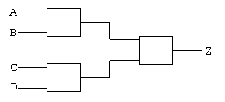
Nets (i)
Can be thought as hardware wires driven by logic
Equal z (high impedance logic level) when unconnected
Various types of nets
  wire
  wand (wired-AND)
  wor (wired-OR)
  tri (tri-state)
nets

Slide 17
Nets (i)
Can be thought as hardware wires driven by logic
Equal z (high impedance logic level) when unconnected
Various types of nets
  wire
  wand (wired-AND)
  wor (wired-OR)
  tri (tri-state)
In following examples: Y is evaluated, automatically, every time A or B changes
nets

Slide 18


Nets (ii)
A
wire Y; // declaration
assign Y = A & B;
Y
B
wand Y; // declaration
assign Y = A;
assign Y = B;
A
Y
B
wor Y; // declaration
assign Y = A;
assign Y = B;
dr
A
Y
tri Y; // declaration
assign Y = (dr) ? A : z;

Slide 19
Registers
Variables that store values
Do not represent real hardware but ..
.. real hardware can be implemented with registers
Only one type: reg
  reg A, C; // declaration
  // assignments are always done inside a procedure
  A = 1;
  C = A; // C gets the logical value 1
  A = 0; // A is 0 now, but C is still 1
  C = 0; // C is 0 now, and A is still 0
Register values are updated explicitly!!

Slide 20
Vectors
Represent buses
  wire [3:0] busA;
  reg [1:4] busB;
  reg [1:0] busC;
Left number is MSB

Slide 21
Vectors
Represent buses
  wire [3:0] busA;
  reg [1:4] busB;
  reg [1:0] busC;
Left number is MSB
Slice management
  busC[1] = busA[2];
  busC[0] = busA[1];
busC = busA[2:1]; ⇔

Slide 22
Vectors
Represent buses
  wire [3:0] busA;
  reg [1:4] busB;
  reg [1:0] busC;
Left number is MSB
Slice management
  busC[1] = busA[2];
  busC[0] = busA[1];
Vector assignment (by position!!)
busB[1] = busA[3];
  busB[2] = busA[2];
  busB[3] = busA[1];
  busB[4] = busA[0];
busC = busA[2:1]; ⇔
busB = busA; ⇔

Slide 23
Integer & Real Data Types
Declaration
  integer i, k; //default 32-bit
  real r;
Use as registers (inside procedures)
  i = 1; // assignments occur inside procedure
  r = 2.9;
  k = r; // k is rounded to 3
Integers are not initialized!!
Reals are initialized to 0.0

Slide 24
Time Data Type
Special data type for simulation time measuring
Declaration
  time my_time;
Use inside procedure
  my_time = $time; // get current sim time
Simulation runs at simulation time, not real time

Slide 25
Arrays (i)
Syntax
  integer count[1:5]; // 5 integers
  reg var[-15:16]; // 32 1-bit regs
  reg [7:0] mem[0:1023]; // 1024 8-bit regs (2D array)
An array of n 1-bit reg is not the same as an n-bit vector reg
  reg A[0:3];//4 1-bit array → column matrix
  reg [3:0]A;//4-bit vector → row matrix
Accessing array elements
  Entire element: mem[10] = 8’b 10101010;
  Element subfield (needs temp storage):
    reg [7:0] temp;
    ...
    temp = mem[10]; //temp = 8’b 10101010;
    var[6] = temp[2]; //var[6] = 0;

Slide 26
Strings
Implemented with regs:
  reg [8*13:1] string_val; // can hold up to 13 chars
  ..
  string_val = “Hello Verilog”;
  string_val = “hello”; // MS Bytes are filled with 0
  string_val = “I am overflowed”; // “I ” is truncated
Escaped chars:
  \n newline
  \t tab
  %% %
  \\ \
  \“ “

Slide 27
Logical Operators
&& → logical AND
|| → logical OR
! → logical NOT
  If any bit of operand is x or z, then the operand is tread as x
Operands evaluated to ONE bit value: 0, 1 or x
Result is ONE bit value: 0, 1 or x
  A = 6; A && B → 1 && 0 → 0
  B = 0; A || !B → 1 || 1 → 1
  C = x; C || B → x || 0 → x
but C&&B=0

Slide 28
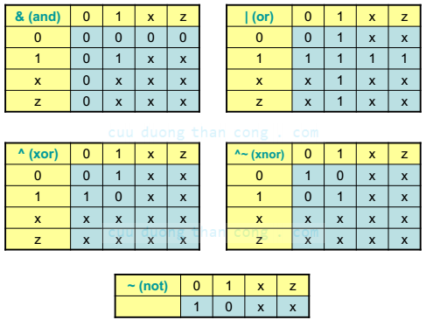
Bitwise Operators (i)
& → bitwise AND
| → bitwise OR
~ → bitwise NOT
^ → bitwise XOR
~^ or ^~ → bitwise XNOR
Operation on bit by bit basis

Slide 29
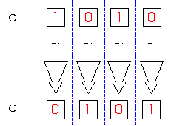
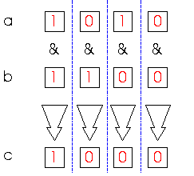
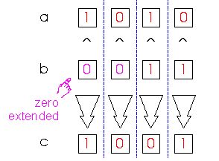
Bitwise Operators (ii)
c = ~a;
c = a & b;
a = 4’b1010;
b = 2’b11;
a = 4’b1010;
b = 4’b1100;
c = a ^ b;

Slide 30
Reduction Operators
& → AND
| → OR
^ → XOR
~& → NAND
~| → NOR
~^ or ^~ → XNOR
One multi-bit operand → One single-bit result
  a = 4’b1001;
  ..
  c = |a; // c = 1|0|0|1 = 1

Slide 31
Shift Operators
>> → logical shift right
<< → logical shift left
Result is same size as first operand, always zero filled
a = 4’b1010;
...
d = a >> 2; // d = 0010
c = a << 1; // c = 0100

Slide 32
Shift Operators
>>> → arithmetic shift right
<<< → arithmetic shift left
Result is same size as first operand
  <<< : zero filled (same as logical shift left)
  >>> : MSB extended
a = 4’b1010;
...
d = a >>> 2; // d = 1110
c = a <<< 1; // c = 0100

Slide 33
Concatenation Operator
{op1, op2, ..} → concatenates op1, op2, .. to single number
Operands must be sized !!
  reg a;
  reg [2:0] b, c;
  ..
  a = 1’b 1;
  b = 3’b 010;
  c = 3’b 101;
  catx = {a, b, c}; // catx = 1_010_101
  caty = {b, 2’b11, a}; // caty = 010_11_1
  catz = {b, 1}; // WRONG !!
Replication ..
  catr = {4{a}, b, 2{c}}; // catr = 1111_010_101101

Slide 34
Relational Operators
> → greater than
< → less than
>= → greater or equal than
<= → less or equal than
Result is one bit value: 0, 1 or x
  1 > 0 → 1
  ’b1x1 <= 0 → x
  10 < z → x
  Note that: if any bit of operand is x or z, then the result is tread as x

Slide 35
Equality Operators
== → logical equality
!= → logical inequality
=== → case equality
!== → case inequality
  4’b 1z0x == 4’b 1z0x → x
  4’b 1z0x === 4’b 1z0x → 1
Return 0, 1 or x
Return 0 or 1

Slide 36
Equality Operators
== → logical equality
!= → logical inequality
=== → case equality
!== → case inequality
  4’b 1z0x == 4’b 1z0x → x
  4’b 1z0x === 4’b 1z0x → 1
  4’b 1z0x != 4’b 1z0x → x
  4’b 1z0x !== 4’b 1z0x → 0
Return 0, 1 or x
Return 0 or 1

Slide 37
Conditional Operator
cond_expr ? true_expr : false_expr

Slide 38
Conditional Operator
cond_expr ? true_expr : false_expr
Like a 2-to-1 mux ..
A
1
Y
B
Y = (sel)? A : B;
0
sel

Slide 39
Arithmetic Operators (i)
+, -, *, /, %
  If any bit of operand is x or z, then the result is tread as x
Negative registers:
  regs can be assigned negative but are treated as unsigned
    reg [15:0] regA;
    ..
    regA = -5’d12; // stored as 2¹⁶-12 = 65524
    regA/3 // evaluates to 21841

Slide 40
Arithmetic Operators (ii)
Negative integers:
  can be assigned negative values
  different treatment depending on base specification or not
    reg [15:0] regA;
    integer intA;
    regA = -12/3; //evaluates to 65532 because regA is unsigned
    intA = -12/3; //evaluates to -4 (no base spec)
    intA = -’d12/3; //evaluates to 1431655761 (base spec)
16-bit two’s complement of (-4)
-4
(signed)
4294967284: 32-bit two’s complement of (-12)
A register data type is seen as unsigned value and an integer date type is seen as a signed value.
An arithmetic operation on a register data type behaves differently than an arithmetic operation on an integer date type.

Slide 41
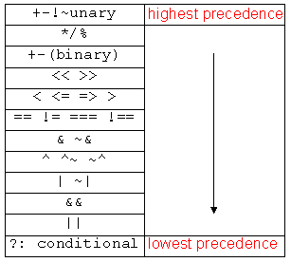
Operator Precedence
sign
Use parentheses to
enforce the priority.

